Slide 1
ENDOMYOCARDIAL FIBROSIS
Dr Jassim kp

Slide 2
References
Tropical Endomyocardial Fibrosis: Natural History, Challenges, and Perspectives . Antonio Grimaldi, Ana Olga Mocumbi
Ana Mocumbi,How Do I Diagnose and Classify Endomyocardial Fibrosis in Under-Resourced Settings, ABCImagemCardiovascular, 37, 1, (2024).
A Population Study of Endomyocardial Fibrosis in a Rural Area of Mozambique :Ana Olga Mocumbi, M.D., Maria Beatriz Ferreira, M.D., Ph.D., Daniel Sidi, M.D., Ph.D., and Magdi H. Yacoub, F.R.S.
Bhatti K, Bandlamudi M, Lopez-Mattei J. Endomyocardial Fibrosis. [Updated 2022 Aug 8]. In: StatPearls [Internet]. Treasure Island (FL): StatPearls Publishing; 2024 Jan-. Available from: https://www.ncbi.nlm.nih.gov/books/NBK513293/

Slide 3
Endomyocardiofibrosis in the Americas Collaborative Study: The EMF-SIAC Registry, Current Problems in Cardiology, 2023Cristhian E. Scatularo, Edith Liliana Posada Martínez, Ana C. Alba, María F. Renedo, Mariano N Llober, Melisa Elfman, Diego Pérez de Arenaza, Mirta Diez, Clara Saldarriaga, Eugenio Cingolani, María Ines Sosa Liprandi,
Sutter, J, Suboc, T, Rao, A. Tropical Endomyocardial Fibrosis. J Am Coll Cardiol Case Rep. 2020 May, 2 (5) 819–822.
Balakrishnan KG, Sasidharan K, Venkitachalam CG, Sapru RP. Coronary angiographic features in endomyocardial fibrosis. Cardiology. 1983;70(3):121-126. doi:10.1159/000173580
Valiathan, M.S., Balakrishnan, K.G. & Kartha, C.C. A profile of endomyocardial fibrosis. Indian J Pediatr 54, 229–236 (1987). https://doi.org/10.1007/BF02750815

Slide 4
Geographical variation in the clinical presentation of endomyocardial fibrosis in India?, 2018 Prabha Nini Gupta, Subair M. Kunju, Baiju Rajan, A. George Koshy, Sunitha Vishwanathan, Preeti Sara George, Praveen Velappan,
,
Surgical Treatment of Endomyocardial Fibrosis M. S. Valiathan, Ch.M., F.R.C.S., F.R.C.S.(C), K. G. Balakrishnan, M.D., D.M., R. Sankarkumar, M.S., M.Ch., and C. C. Kartha, M.D.
Sivasankaran S. Restrictive cardiomyopathy in India: the story of a vanishing mystery. Heart. 2009;95(1):9-14. doi:10.1136/hrt.2008.148437
Vijayaraghavan G, Sivasankaran S. Tropical endomyocardial fibrosis in India: a vanishing disease! Indian J Med Res. 2012 Nov;136(5):729-38. PMID: 23287119; PMCID: PMC3573593.

Slide 5
Outline
Introduction
History
Epidemiology
Pathogenesis
Pathology
Natural history and presentation
How to diagnose
Imaging
Management

Slide 6
Progressive disease of unclear etiology and pathogenesis
Characterized by fibrosis of the apical endocardium of the right ventricle (RV), left ventricle (LV), or both
Endemic restrictive cardiomyopathy
Tropical and subtropical regions
Notes:
Commonest form of ERC
The clinical manifestations are largely related to theconsequences of restrictive ventricular filling, includingleft and right sided heart failure. The heart failure is associated with atrioventricular-valveregurgitation

Slide 7
It is classified as a restrictive cardiomyopathy, with pathophysiology of restriction to diastolic filling associated with valve abnormalities, both caused by endocardial fibrosis.
Typical echocardiographic features –
- Endocardial thickening
- Severe atrioventricular (AV) valve regurgitation
- Aneurysmal atria
- Heart distortion

Slide 8
History
1946 - Bedform and Konstam published findings from post mortem analysis of 40 west African soldiers - World War II
Heart Failure of Unkown Origin in Africans - The British Heart Journal.
1948- Jack N.P. Davies identified Endomyocardial fibrosis and coined the word after studying the condition in Uganda
Notes:
.▪ They attributed the disease to an unknown aetiology and the title of their paperwas

Slide 9
JD Ball- joined Christian Medial College Vellore in India and identified the pathological specimens at autopsy which he shipped to Davies for confirmation→reported from India for the first .
1954 : Davies - classical pathological features and its distribution in Africa.
Right and left ventricular endocardial fibrosis, affecting the apex and inflow region with atrioventricular valve regurgitations - Davies’ disease
Notes:
1948 : Bedford encouraged davies to publish his observations andArthur Williams and JD Ball were his co-authors

Slide 10
1960 : Samuel and Anklesaria published initial autopsy series from south India.
1962 : CK Gopi - Trivandrum, described the specimen kept in the hospital autopsied in 1950s as a case of right ventricular endomyocardial fibrosis with right atrial thrombi.

Slide 11
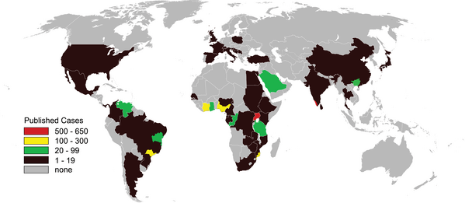
EPIDEMIOLOGY
Tropical and subtropical regions
Sub – saharan africa:
Uganda
Mozambique (20% rural prevalence)
West africa : Nigeria , Guinea
India – kerala
China – Guangxi
South america – brazil ,colombia
Notes:
. EMF is prevalent in Kerala State, India, and in Uganda, where more detailed studies have been done (Connor et al. 1967, 1968; Valiathan et al. 1993

Slide 12
Geographical distribution within 15 degrees on either side of the equator

Slide 13
Affects predominantly young adults - lower socioeconomic status
A study in Uganda indicated a bimodal peak at 10 and 30 years of age.
No specific data on gender predisposition.
A recent decline observed in India and some regions of Nigeria → potential influence of socioeconomic and environmental factors on the disease
Notes:
Studies on gender distribution have been mixed, and currently, there is no specific data on gender predisposition.

Slide 14
Prevalence-19.8%
Biventricular - 55.5%
Right sided-28.0%
Left sided -16.6%
Symptomatic - 22.7%
Prevalence highest -10 to 19 years of age

Slide 15
Notes:
he objective of the present study is to examine
whether the pattern of geographical distribution of EMF
in southern Kerala is consistent with the geochemical
hypothesis which links the origin of the disease to
magnesium deficiency and toxicity to the heart from the
monazite element cerium

Slide 16
High density of EMF - four taluks near the coastline situated within the districts of Alapuzha, Kollam, and Pathanamthitta
Two coastal taluks in Kollam and Alapuzha districts are known areas of deposits of monazite elements in the state
Geographical distribution is not related to prevalence of filariasis and eosinophilia
Conclusion - Coexistence of high density of occurrence of EMF and deposits of monazite elements support the geochemical hypothesis

Slide 18
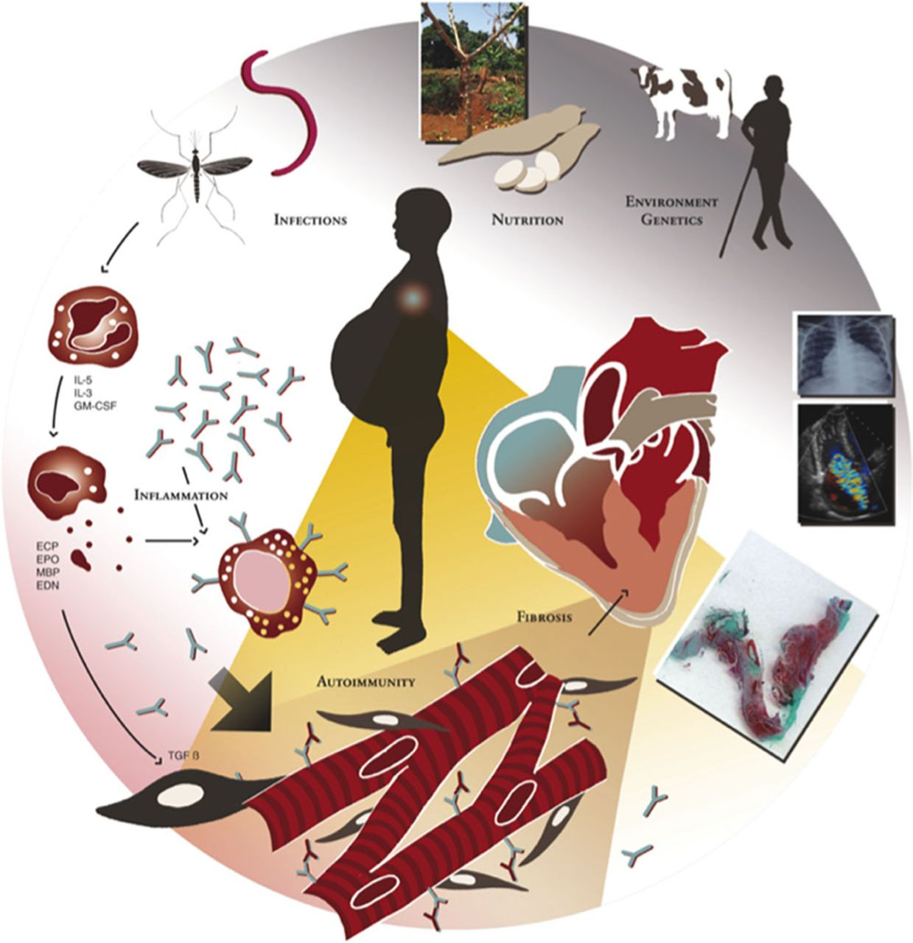
Pathogenesis
Unclear
Potential multifactorial pathogenesis-
Eosinophilia
Infectious Disease
Autoimmunity
Environmental Factors
Dietary Factors
Toxins
Genetic Susceptibility

Slide 19
Eosinophilia

Slide 20
eosinophil–mast cell–fibroblast cross-talk
- Triggers synthesis of collagen by fibroblasts
Notes:
Once activated by interleukin (IL)-3, IL-5, and granulocyte-macrophage colony-stimulating factor (GM-CSF), the eosinophils express their toxicity through (1) proteins from degranulation, which in turn activate the cardiac mast cells, also triggered by circulating IgE; (2) profibrotic role by stimulating the fibroblasts via transforming growth factor-β (TGF-β); and (3) a profibrotic role by directly triggering the synthesis of collagen by fibroblasts

Slide 21
Infectious Disease
Prevalence of parasites in the endemic countries
Hyperimmune malaria-related splenomegaly among Rwandan immigrants affected by EMF
Plasmodium species
Microfilaria
Schistosoma
Helminths
Arboviruses
Toxoplasma
Notes:
Similarities with the Loffler syndrome^{47,48} and the prevalence of parasites in the endemic countries^{26,27} led to consider eosinophilia and infections as potential primary triggers

Slide 22
lack of difference in parasitic loads between EMF patients compared with control subjects
countries with similar burdens of malaria and filariasis - do not have reported cases of EMF

Slide 23
Environmental Factors, Dietary Factors, and Toxins
Magnesium deficiency
Cerium toxicity-increased quantities in affected areas
Cyanogenic glycosides
High vitamin D
Serotonin toxicity
Herbal preparations

Slide 24
Cassava
Important dietary staple for >500 million people in developing countries
cheaper - proper processing/cooking
Toxic cyanogenic glycoside - linamarin →
liberate hydrogen cyanide in the gut
sublethal doses of cyanide →Tissue hypoxia and lipid peroxidation→ alters myocardial cell biology
Animal models- development of intracellular vacuoles, endocardial thickening, and interstitial fibrosis
Notes:
Animal models- development of intracellular vacuoles, endocardial thickening, and interstitial fibrosis has been demonstrated with cassava intake

Slide 25
Genetic susceptibility
Instances of familial occurrence
Rare cases among very young children
Ethnic clustering of cases
Role of genetic predisposition in EMF is unclear at present
Notes:
in Uganda, EMF is more common among immigrants from neighboring Rwanda and Burundi,¹³ but it also occurs in whites who have lived in endemic regions^{57,76,93,94} or in immigrants coming from areas where the disease is anecdotal. Thus, the role of genetic predisposition in EMF is unclear at present and needs further study.

Slide 26
Pathology
Histopathology
Endocardial thickening –hallmark- a feature of advanced disease
No primary involvement of extra-cardiac organs
Mild to moderate inflammatory infiltrates -lymphocytes →interface between the endocardium and the myocardium
Inflammatory infiltrates, interstitial fibrosis, and scars
Notes:
yocardial lesions such as inflammatory infiltrates, interstitial fibrosis, and scars are prominent in areas adjacent to subendocardial fibrosis and altered vessels, suggesting that they likely occur in response to ischemic injury caused by microvascular changes

Slide 27
Macroscopical appearance
Pericardial sac -adhesions between the parietal and visceral layers.
ventricles look small with grossly dilated atria
Thrombosis and fibrosis are characteristically prominent in ventricular apices and at the posterior wall of the left ventricle, behind the posterior leaflet of the mitral valve
Scar tissue- apical obliteration
-fixation, and obliteration of the papillary muscles and chordae tendineae.
LV apex is frequently scarred and thrombosed, but never contracted.
semilunar valves and the great vessels are usually not involved
Notes:
The pericardial sac may present adhesions between the parietal and visceral layers. Thrombosis and fibrosis are characteristically prominent in ventricular apices and at the posterior wall of the left ventricle, behind the posterior leaflet of the mitral valve [36]. The scar tissue may be massive, causing apical obliteration, as well as fixation, and obliteration of the papillary muscles and chordae tendineae. The left ventricular apex is frequently scarred and thrombosed, but never contracted. The semilunar valves and the great vessels are usually not involved

Slide 28
Notes:
Postmortem heart specimen of a young boy who died
as a result of severe mitral regurgitation caused by left-sided
EMF. Black arrow indicates scar at the apex of the left ventricle.
Note that the left ventricle is small and the left atrium is
enlarged and the retracted posterior leaflet of the mitral valve is
involved in the fibrotic process (blue arrow).

Slide 29
Microscopy
Fibro -collagen tissue deposition underneath the endothelial layer of the endocardium
Mild to moderate inflammatory infiltrates -lymphocytes →interface between the endocardium and the myocardium
Intense eosinophilic infiltrates - unusual
Notes:
endocardial thickening due to acellular fibro-collagen tissue deposition underneath the endothelial layer of the endocardium

Slide 30
Notes:
Figure 6. Histology of the LA demonstrates marked fibrotic thickening of the endocardium (arrow), with proliferation of fibrous tissue in the underlying myocardium, which is consistent with endomyocardial fibrosis (Masson trichrome stain, original magnification ×50).

Slide 31
Natural History and Presentation
Active phase
Recurrent flare-ups of inflammation
Chronic phase
Restrictive heart failure.
Notes:
active phase with recurrent flare-ups of inflammation evolving to a chronic phase leading to restrictive heart failure

Slide 32
Active Form: Inflammation
Usually starts with a febrile illness
Pancarditis
Dyspnea , itching, and periorbital swelling
Eosinophilia - morphologically abnormal
Acute inflammation - myocardial edema, eosinophilic infiltration, subendocardial myofiber necrosis, and vasculitis

Slide 33
ECG - nonspecific
low-voltage QRS
ST-T–wave changes
conduction disturbances
atrial or ventricular arrhythmias
ECHO- homogeneous infiltrates fill in layers of the cardiac walls
pericardial effusion
Mural thrombi - endocardial surfaces of the apical and valvular pockets

Slide 34
some cases evolve rapidly to heart failure and death
some cases pass through a subacute “burnout” phase without sequelae

Slide 35
Transient Progressive Form: Toward the Chronic Phase
Recurrence of active episodes→chronic phase of EMF
Inflammation – rare
Chronic heart failure - edema and ascites
Ascitic fluid -exudative - mostly lymphocytes
Varying degrees of cardiomegaly , and only exceptionally reveal the typical linear endocardial calcifications.
Notes:
recurrence of active episodes may facilitate the evolution to the chronic phase of EMF
With such an evolution, systemic inflammation becomes rare,^{13,107,108} and markers of inflammatory activity such as hypoalbuminemia and liver or kidney dysfunction are rarely observed
ascitic fluid in patients with EMF is mostly exudative with a pleocytosis of white blood cells, mostly lymphocytes

Slide 36
ECHO- affected areas unevenly evolve into endocardial scars
Restrictive - chamber distortion and dilated atria
Fibrotic process stops abruptly just before the ventricular outflow tract.
Endomyocardial calcification spots - marker of burnt-out disease
Notes:
as the myocardium returns to normal thickness, the affected areas unevenly evolve into endocardial scars (Figure 2B and 2C), and a restrictive syndrome occurs with chamber distortion and dilated atria (Figure 2D). Typically, the fibrotic process stops abruptly just before the ventricular outflow tract. The occurrence of endomyocardial calcification spots is usually a marker of burnt-out disease³³ resulting from intermittent flare-ups of inflammation alternating with quiescent phases.

Slide 38
Chronic Form
Biventricular involvement – MC presentation (up to 55%)
Followed by isolated right-sided heart involvement
In rare cases, isolated left-sided heart disease

Slide 39
Clinical manifestations
Depends on the ventricle affected, the duration of disease
Related to the presence of right and/or left heart failure.

Slide 40
Prevalence-19.8%
Biventricular - 55.5%
Right sided-28.0%
Left sided -16.6%
Symptomatic - 22.7%
Prevalence highest -10 to 19 years of age

Slide 42
LV EMF
Dyspnea on exertion
Paroxysmal nocturnal dyspnea
Orthopnea

Slide 43
RV EMF
Presents with chronic systemic venous hypertension
Leads to
Exophthalmos, elevated jugular pressure
Gross hepatomegaly
Ascites
Lower extremity, and abdominal swelling
Chronic thromboembolism may lead to pulmonary hypertension

Slide 44
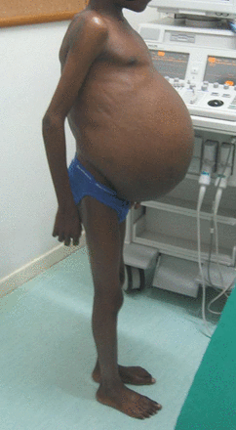
Marked ascites out of proportion to peripheral edema
Peritoneal fibrosis →propose an EMF systemic syndrome with peritoneal inflammation
Notes:
Abundant ascites with lymphocytic exudates and peritoneal fibrosis but without pedal edema had led researchers to propose an EMF systemic syndrome with peritoneal inflammation

Slide 45
Non-specific
Digital clubbing
Growth retardation
Testicular atrophy
Failure to develop male secondary sexual characteristics
Cachexia
More specific features
Hypertrophy of the parotid gland
Periorbital edema
Proptosis

Slide 46
Atrial fibrillation - >30%
first-degree atrioventricular block or RBBB are common
Mortality-
progressive heart failure
sudden death caused by pulmonary thromboembolism or ventricular arrhythmias
Notes:
¹Conduction abnormalities such as

Slide 48
Definite diagnosis
2 major criteria
or
1 major + 2 minor criteria.
Total score
<8 - mild EMF
8 to 15 - moderate
>15 - severe disease

Slide 50
Established bilateral EMF - the heart has a peculiar aspect of enlarged atria with small ventricles - the “Mickey mouse” heart - 4 chambers view

Slide 52
In a patient with an echocardiographic diagnosis of EMF
Activity was defined as - two or more of the following signs:
Unexplained fever, recurrent facial edema, urticaria or asthma-like episodes
Severe hypereosinophilia (absolute eosinophil count > 1.5 x 109/L)
Ventricular thrombi not attributable to severe myocardial dysfunction
Evidence of pancarditis with acute heart failure
Increased C-Reactive Protein and/or erythrocyte sedimentation rate

Slide 53
Active EMF with remission - signs of activity at diagnosis that regressed during the first six months of follow up
Active persistent - persistence of signs of activity for 6 months or more
Active rapidly progressive - persistence of signs of activity after the initial episode of heart failure, who progress to a higher degree of severity or death in less than six months
Quiescent or Recurrent - occurrence of disease recrudescence during the first six months of follow up
Chronic recurrent - recrudescence of active disease in the course of follow up, going back to a quiescent stage thereafter

Slide 54
X-ray
Pronounced cardiomegaly
Biatrial dilatation
Pulmonary infundibular dilatation
Postcapillary pulmonary hypertension
Pleural and pericardial effusions are very common
Notes:
Left, A 10-year-old girl with severe cardiomegaly secondary to a giant left atrium and massive mitral insufficiency in left EMF. She was operated on with excision of the fibrotic endocardium, mitral valve repair/replacement, and atrial reduction. Right, A 12-year-old boy with severe cardiomegaly caused by aneurysmal right atrium in right EMF.

Slide 55
Cardiac catheterization
Not required for the diagnosis of EMF
Depending on ventricle involved, MR and TR may be demonstrated
When performed, the classic “dip and plateau” pattern (or square root sign) in the right ventricular pressure tracing, pulmonary arterial hypertension can be seen
Notes:
(image 2) [43].

Slide 57
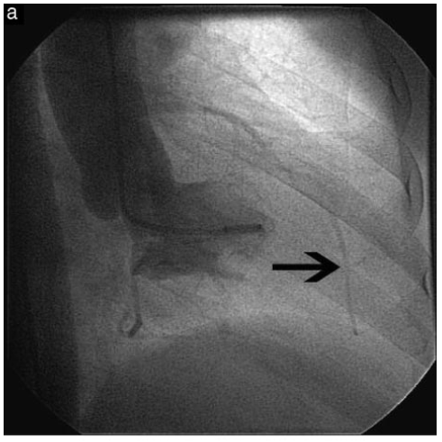
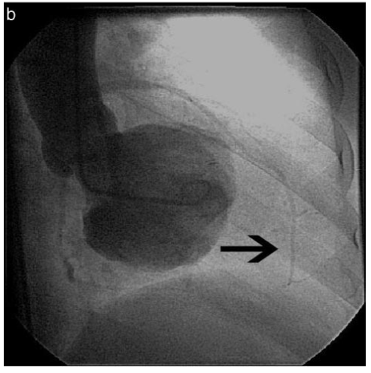
Angiography Characteristic obliteration of the apex of the involved ventricle(s) with varying degree of AV valve regurgitation
LV-RAO view
Notes:
Angiography
characteristic obliteration of the apex of the involved ventricle(s) with varying degree of AV valve regurgitation in all patients with left ventricular
or biventricular EMF
. In patients with right ventricular involvement, there was obliteration of the right ventricular apex with dilation of the outflow tract. right ventricular inflow and outflow with obliteration

Slide 58
Notes:
End-systolic (A) and end-diastolic (B) frames of the left ventriculography show partial obliteration of the cavity with late filling of the apex, which was occupied by prominent trabeculations and moderate mitral regurgitation

Slide 59
Notes:
A 48-year-old man presented with chronic right sided heart failure. 2D echocardiography revealed the classical features of left ventricular endomyocardial fibrosis with a prominent right ventricular apical aneurysm. Right ventriculography further defined the aneurysm
Cine angiographic frames of the right ventricle in the postero-anterior view at systole showing large apical aneurysm with septations (single headed arrow). Right atrium is dilated. Note the dilated right ventricular outflow tract (double headed arrow). (E) Cine angiographic frames of the left ventricle in the right anterior oblique view at end-diastole showing obliteration of ventricular apex.

Slide 62
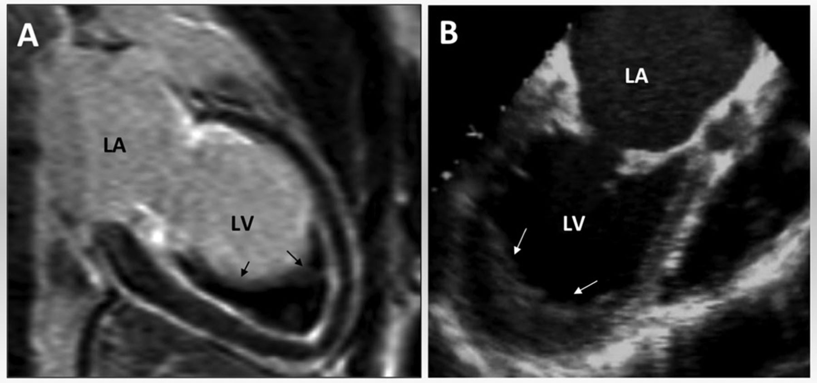
Cardiac MRI
Provides additional value for the diagnosis of EMF
Potential assessment of early disease
Outlines the degree of chamber distortion and the extent of thrombosis
Notes:
large apical thrombus attached to the fibrotic endocardium and reducing the left ventricular cavity.

Slide 63
Perfusion studies accurately map the hypoperfused myocardial areas and avascular structures
Late -gadolinium-enhancement images correlate with fibrosis.
Ideal tool for monitoring the response to treatment and for defining anatomic details before surgery

Slide 64
Notes:
Steady-state free-precession 4-chamber view cine MRI demonstrates right and left atrial dilatation and TR, with the origin of the TR jet dislocated toward the apex of the right ventricle (RV; arrow), possibly secondary to papillary muscle fibrosis. RA indicates right atrium; LA, left atrium; and LV, left ventricle.

Slide 65
Notes:
Steady-state free-precession cine MRI demonstrates left atrial dilatation and mitral regurgitation (arrow). RVOT indicates right ventricular outflow tract; other abbreviations as in Figure 2.

Slide 66
Notes:
Delayed-enhancement MRI of left ventricle radial view demonstrates subendocardial hyperenhancement of the apex of the left ventricle, suggesting fibrosis (arrows)

Slide 67
Management
Symptomatic treatment of heart failure
Anticoagulation is recommended in patients who have a thrombus
surgery increases survival compared with medical treatment
Surgical endocardectomy and valve repair/replacement

Slide 68
surgery not suitable for
End -Stage EMF
Clinical Signs Of Advanced Disease Such As Gross And Long-standing Ascites
Chronic Pulmonary Thromboembolism
Extensive Endocardial Fibrosis
Right Ventricular Hypoplasia
Extreme Cachexia.

Slide 69
Early postoperative mortality may be up to 20%
Variable rates of recurrence after surgery
Timely surgical treatment still appears to be the only option to substantially improve outcomes at present.

Slide 71
46 patients with EMF underwent endocardiectomy and AV valve replacement 1981- 1984 Sree Chitra Tirunal Institute
Six patients in NYHA III and 40 in Class IV
Operative mortality within 30 days of the procedure - 21.7%
late mortality during the first two years postoperation - 13%
Survival inclusive of operative mortality at two years was 67%

Slide 73
Temporal correlates of this changing natural history are worth analyzing.
The period noted in the natural history studies belong to the 30 year period of 1976 to 2007
During the same period, Kerala witnessed substantial economic, nutritional and health transitions
Cassava and plantain are no longer the staple diet for the Keralites.
The per capita calorie consumption increased from 1600 to 2100 Kcals.
The nutritional deficiency disorders were replaced by those of overnutrition.
Substantial decline in worm load per child
Filarial endemicity continues to be little less, with rigorous governmental programmes initiated for its control
Eosinophilia in children is now uncommon

Slide 74
Conclusion
EMF presents great phenotypic variability
lesions varying from patchy endocardial thickening without any hemodynamic changes, to extensive mural and AV valve endocardial fibrosis with resulting structural and hemodynamic changes.
Advanced forms of EMF have high morbidity and mortality, with death occurring due to progression to chronic heart failure or as a result of arrhythmia and thromboembolism

Slide 75
Echocardiography allows a confident noninvasive diagnosis of EMF
Typical echocardiographic features –
-Endocardial thickening
- Severe atrioventricular (AV) valve regurgitation
- Aneurysmal atria
- Heart distortion
Surgical techniques have been progressing,but outcomes are yet to be fully understood.

Slide 76
MCQ
EMF also known as
Harveys disease
Cassava disease
Davies disease
Temperate restrictive cardiomyopathy

Slide 77
Which of the following is not a characteristic echo feature of EMF
Endocardial thickening
Severe atrioventricular (AV) valve regurgitation
Aneurysmal atria
Dilated ventricle

Slide 78
Prevalence of biventricular EMF in study from mozambique
40%
70%
55%
20%

Slide 79
Which of the following doesnot indicate activity of EMF
Unexplained fever, recurrent facial edema, urticaria or asthma-like episodes
Ventricular thrombi attributable to severe myocardial dysfunction
Evidence of pancarditis with acute heart failure
Increased C-Reactive Protein and/or erythrocyte sedimentation rate

Slide 80
Which of the following is not included in major criteria for EMF
Endocardial plaque of thickening greater than 2mm
Patchy endocardial thickening in two or more ventricular walls
Obliteration of LV/ RV apex
Retraction of LV apex

Slide 81
Thank you

